Slide 1
Back propagation (Supervised) and Kohonen SOM (Unsupervised)

Slide 2
LAYERS IN NEURAL NETWORK
The input layer:
Introduces input values into the network.
No activation function or other processing.
The hidden layer(s):
Performs classification of features.
Two hidden layers are sufficient to solve any problem.
Features imply more layers may be better.
The output layer:
Functionally is just like the hidden layers.
Outputs are passed on to the world outside the neural network.

Slide 3
MULTILAYER FEEDFORWARD NETWORK
Inputs
Hiddens
I₀
Outputs
h₀
I₁
o₀
h₁
I₂
o₁
h₂
Outputs
I₃
Hiddens
Inputs

Slide 4
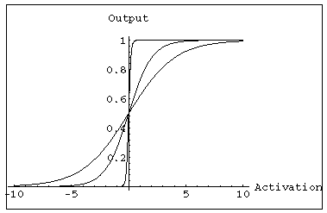
MULTILAYER FEEDFORWARD NETWORK:
ACTIVATION AND TRAINING
For feed forward networks:
A continuous function can be differentiated allowing gradient-descent.
Back propagation is an example of a gradient-descent technique.
Uses sigmoid (binary or bipolar) activation function.

Slide 5
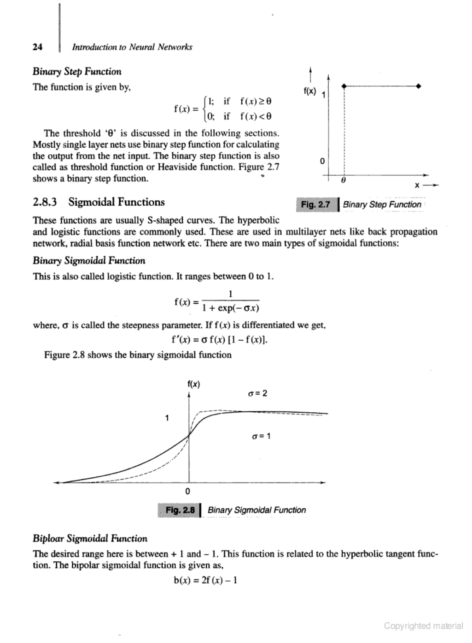
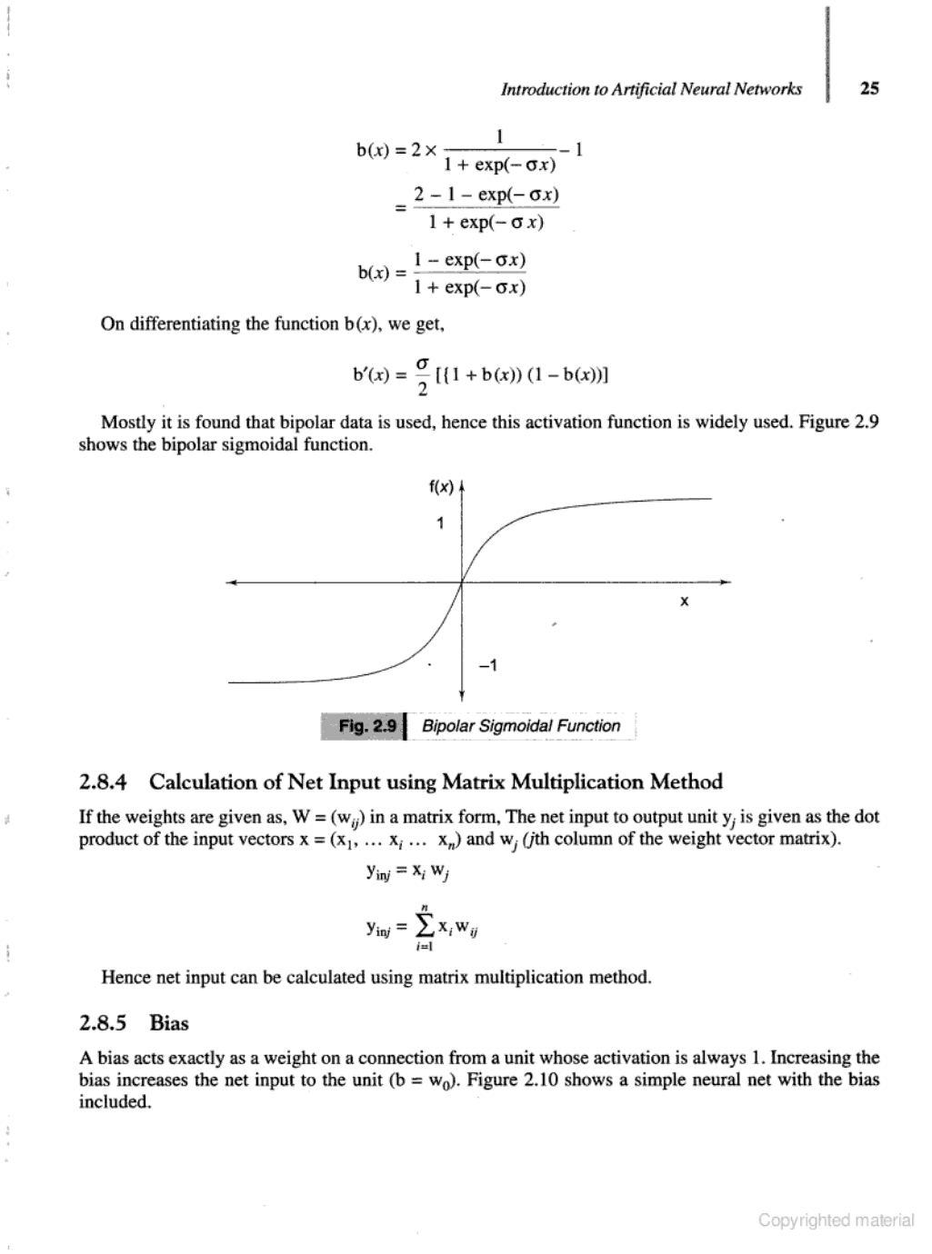
In multilayer networks, the activation function is usually more complex than just a threshold function, like 1/[1+exp(-x)] or even 2/[1+exp(-x)] – 1, etc.
Binary Sigmoidal Function
Bipolar Sigmoidal Function

Slide 6
In multilayer networks, the activation function is usually more complex than just a threshold function, like 1/[1+exp(-x)] or even 2/[1+exp(-x)] – 1, etc.
Binary Sigmoidal Function
Bipolar Sigmoidal Function

Slide 7
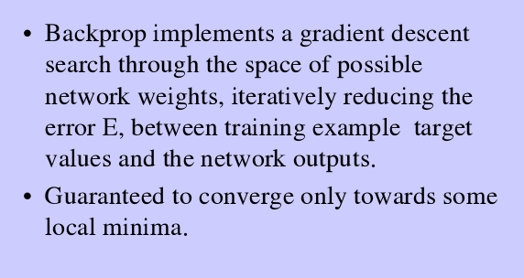
BACK PROPAGATION NETWORK

Slide 8
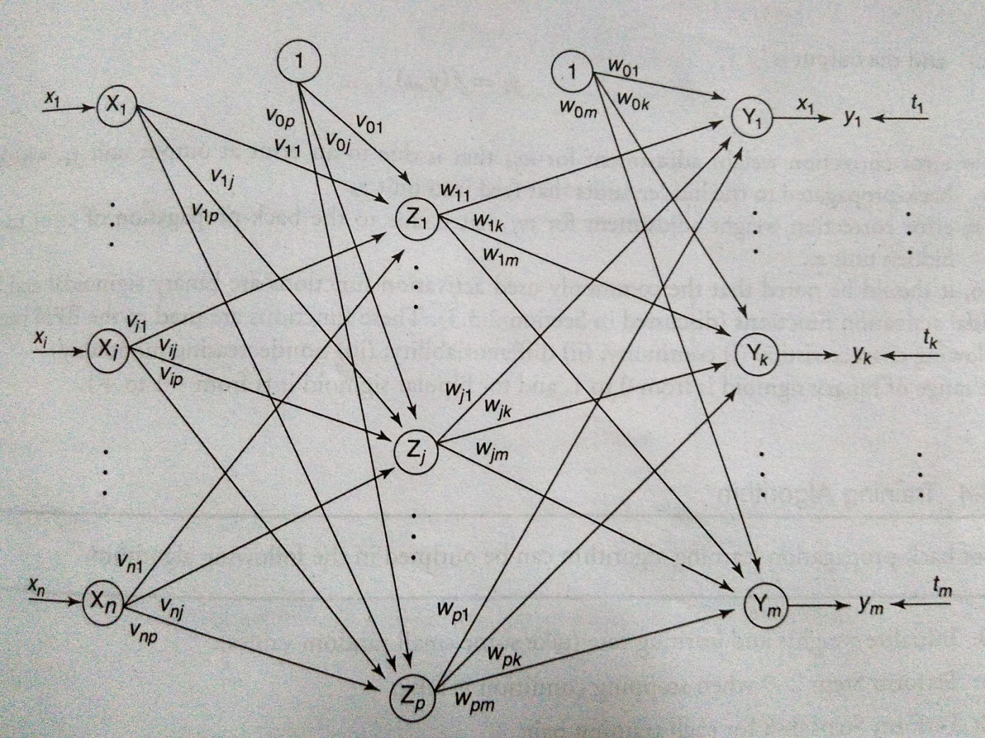
A training procedure which allows multilayer feed forward Neural Networks to be trained.
Can theoretically perform “any” input-output mapping.
Can learn to solve linearly inseparable problems.

Slide 9
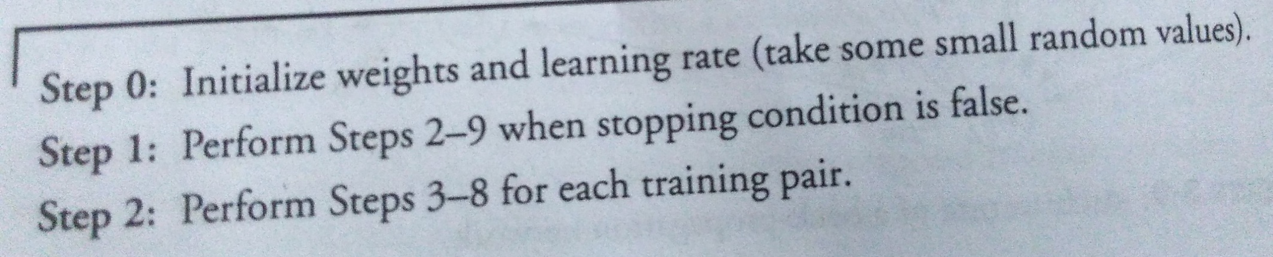
BACKPROPAGATION TRAINING ALGORITHM

Slide 10
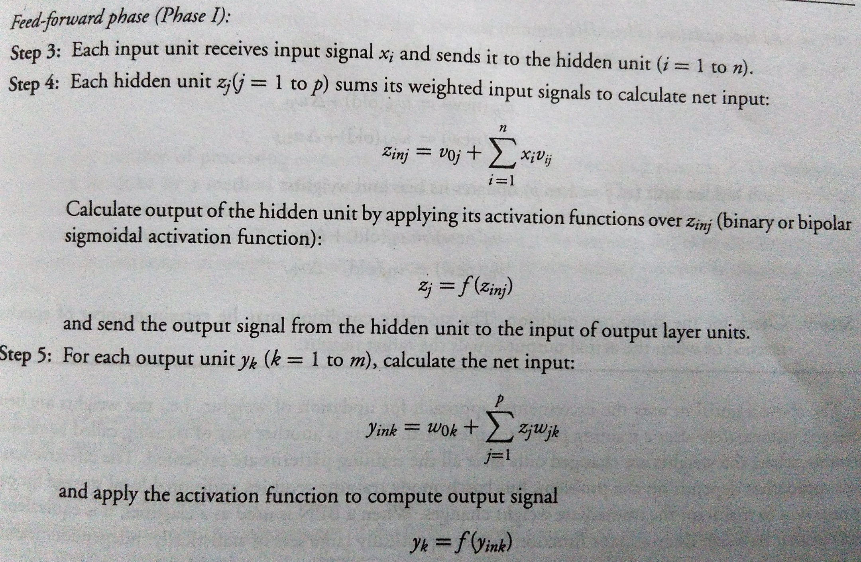
BACKPROPAGATION TRAINING ALGORITHM

Slide 11
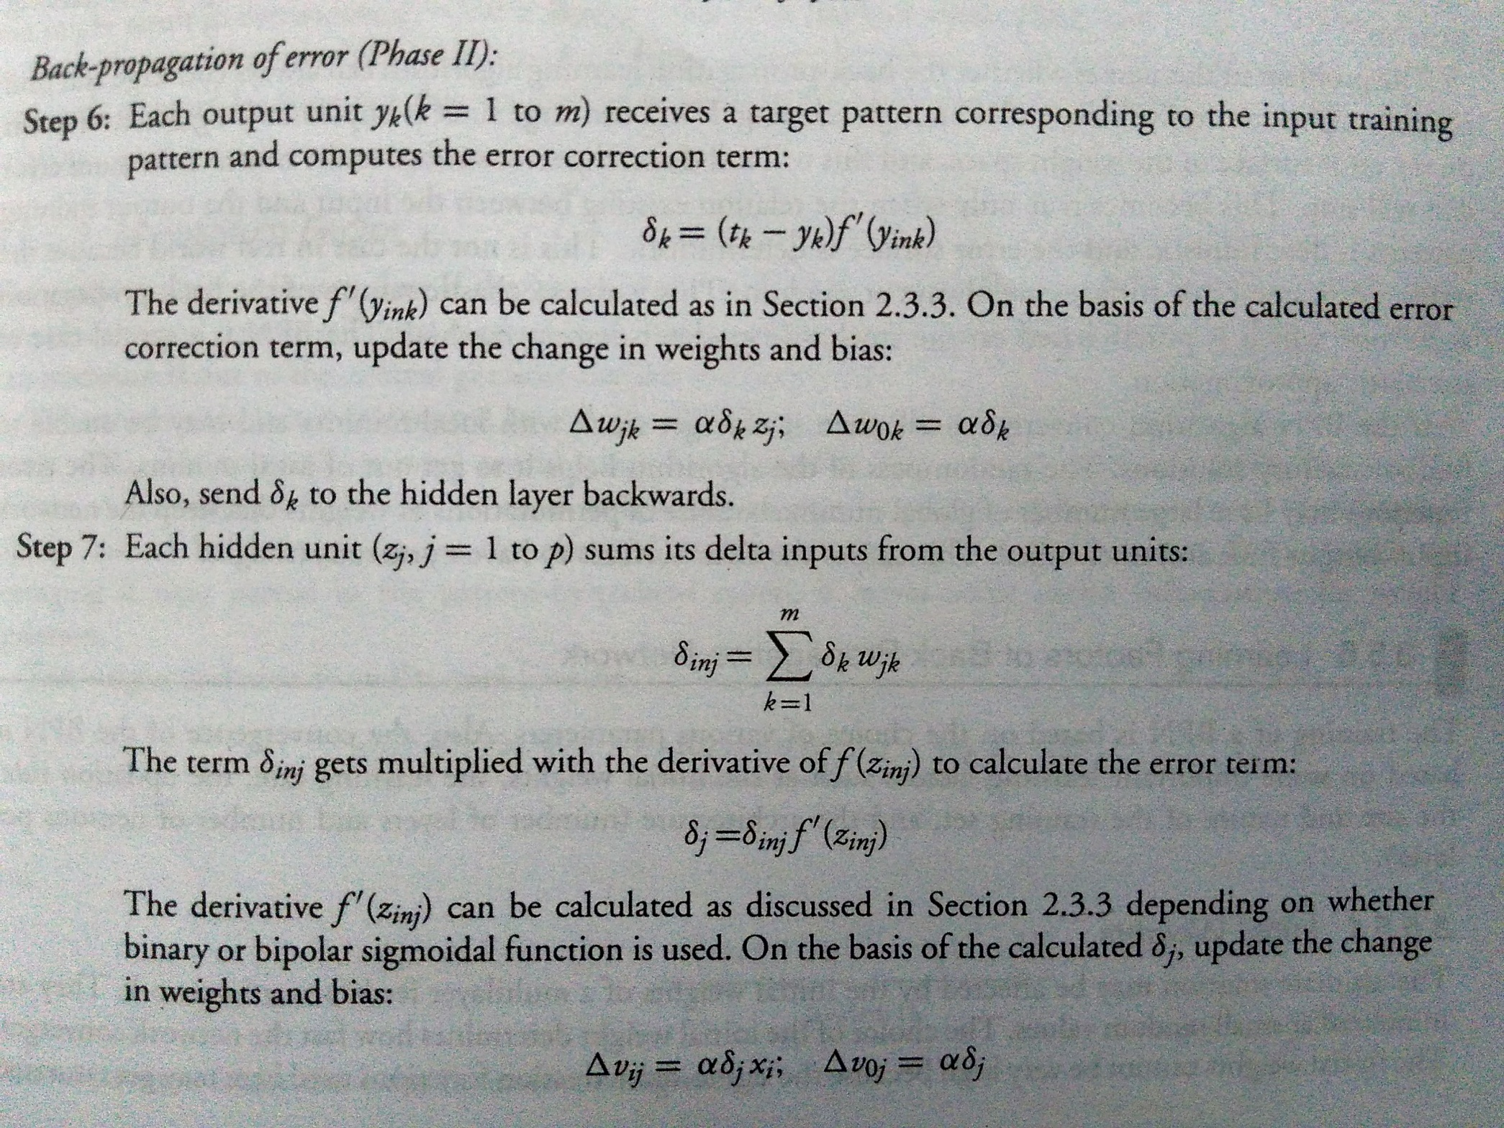
BACKPROPAGATION TRAINING ALGORITHM

Slide 12
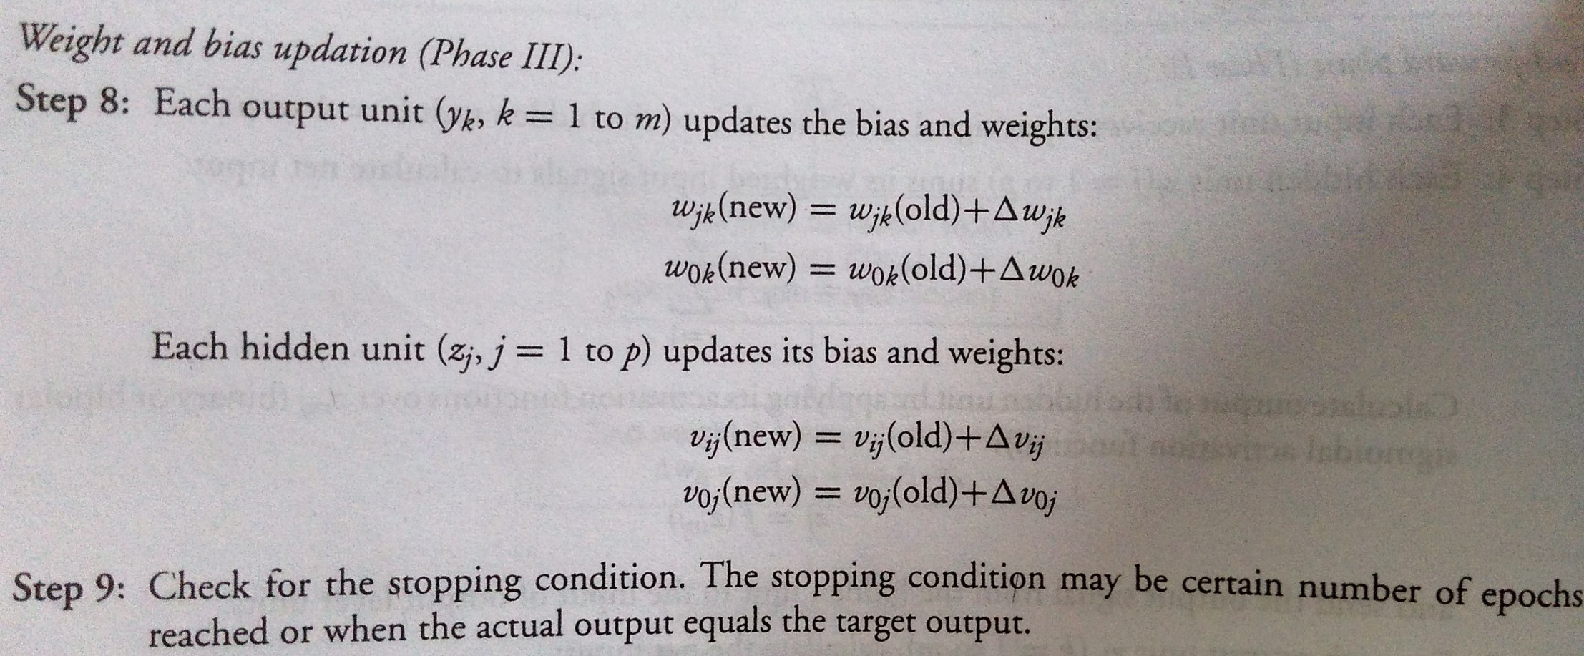
BACKPROPAGATION TRAINING ALGORITHM

Slide 13
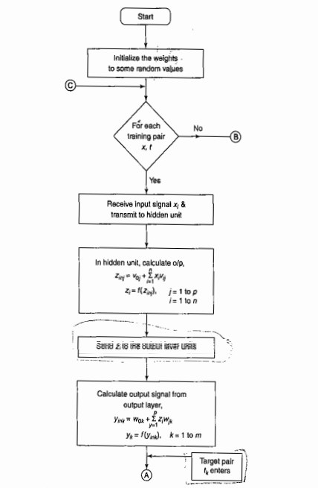

Slide 14
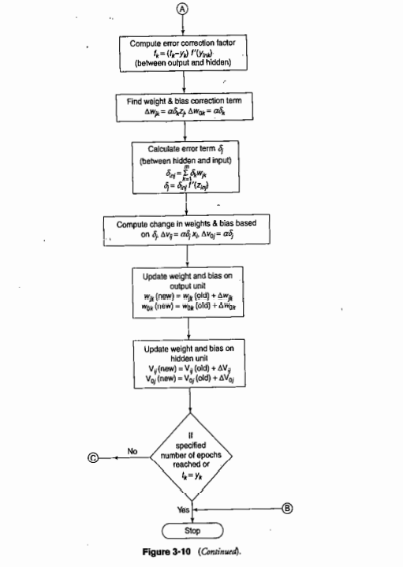

Slide 15
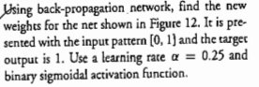
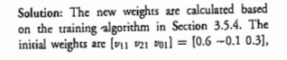
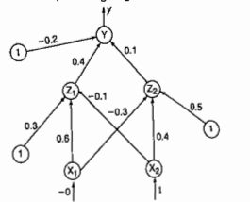
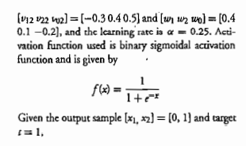

Slide 16
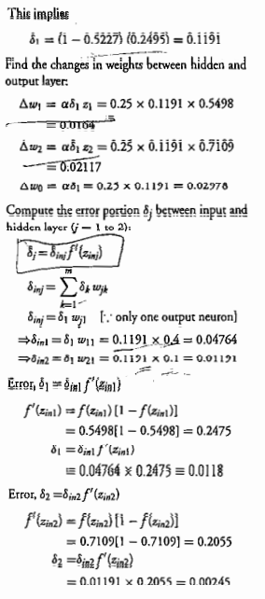
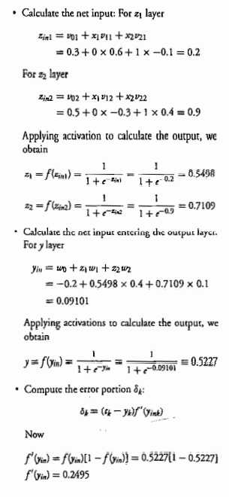

Slide 17
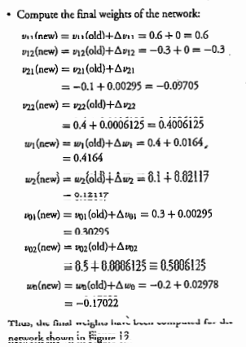
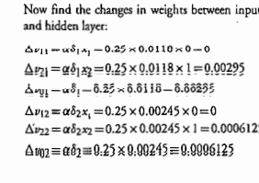
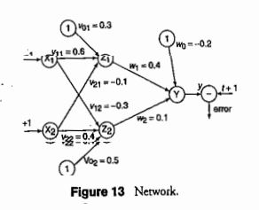

Slide 18
BACKPROPAGATION
Gradient descent over entire network weight vector
Easily generalized to arbitrary directed graphs
Will find a local, not necessarily global error minimum -in practice often works well (can be invoked multiple times with different initial weights)
Often include weight momentum term
Minimizes error training examples
Will it generalize well to unseen instances (over-fitting)?

Slide 19
APPLICATIONS OF BACKPROPAGATION
NETWORK
Load forecasting problems in power systems.
Image processing.
Fault diagnosis and fault detection.
Gesture recognition, speech recognition.
Signature verification.
Bioinformatics.
Structural engineering design (civil).

Slide 20
UNSUPERVISED LEARNING

Slide 21
UNSUPERVISED LEARNING
No help from the outside.
No training data, no information available on the desired output.
Learning by doing.
Used to pick out structure in the input:
Clustering,
Reduction of dimensionality → compression.
Example: Kohonen’s Learning Law.

Slide 22
Self Organizing Maps – Kohonen Maps
It is a type of Artificial Neural Network which is also inspired by biological models of neural systems from the 1970s.
It follows an unsupervised learning approach and trained its network through a competitive learning algorithm.
SOM is used for clustering and mapping (or dimensionality reduction) techniques to map multidimensional data onto lower-dimensional which allows people to reduce complex problems for easy interpretation.

Slide 23
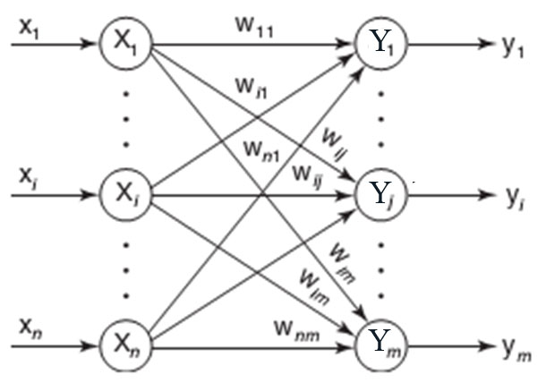
ARCHITECTURE OF KSOFM

Slide 24
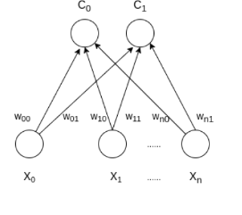
SOM has two layers, one is the Input layer and the other one is the Output layer. The architecture of the Self Organizing Map with two clusters and n input features of any sample is given below:

Slide 25
A Self-Organising Map, additionally, uses competitive learning as opposed to error-correction learning, to adjust it weights. This means that only a single node is activated at each iteration in which the features of an instance of the input vector are presented to the neural network, as all nodes compete for the right to respond to the input.
The chosen node — the Best Matching Unit (BMU) — is selected according to the similarity, between the current input values and all the nodes in the grid.
The node with the smallest Euclidean difference between the input vector and all nodes is chosen, along with its neighbouring nodes within a certain radius, to have their position slightly adjusted to match the input vector.
By going through all the nodes present on the grid, the entire grid eventually matches the complete input dataset, with similar nodes grouped together towards one area, and dissimilar ones separated.

Slide 26
How it works
Let’s say an input data of size (m, n) where m is the number of training examples and n is the number of features in each example. First, it initializes the weights of size (n, C) where C is the number of clusters. Then iterating over the input data, for each training example, it updates the winning vector (weight vector with the shortest distance (e.g Euclidean distance) from training example). Weight updation rule is given by :

Slide 27
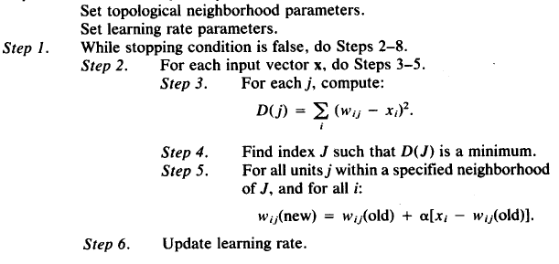
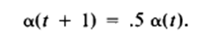
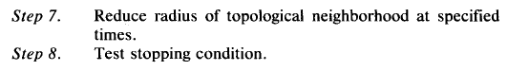
KSOFM ALGORITHM
Step 0. Initialize weights w_{ij} to a small random
values, say in an interval [0, 1].

Slide 28
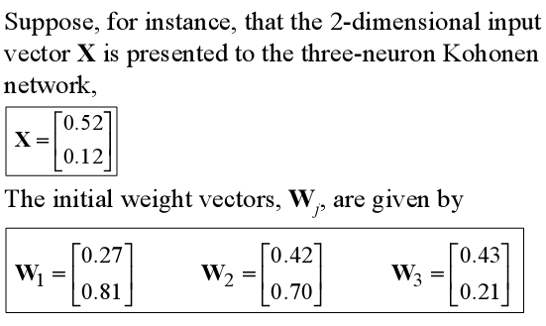
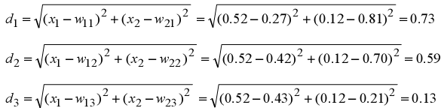
EXAMPLE OF KSOFM
Find the winning neuron using the Euclidean distance:

Slide 29
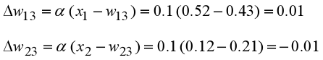
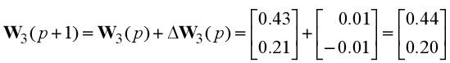
Neuron 3 is the winner and its weight vector W₃ is updated according to the competitive learning rule:
The updated weight vector W3 at iteration (p+1) is determined as:
The weight vector W3 of the winning neuron 3 becomes closer to the input vector X with each iteration.

Slide 30
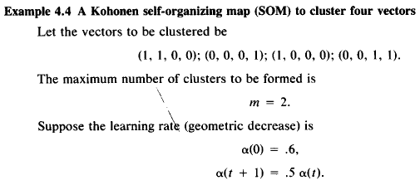
EXAMPLE OF KSOFM

Slide 31
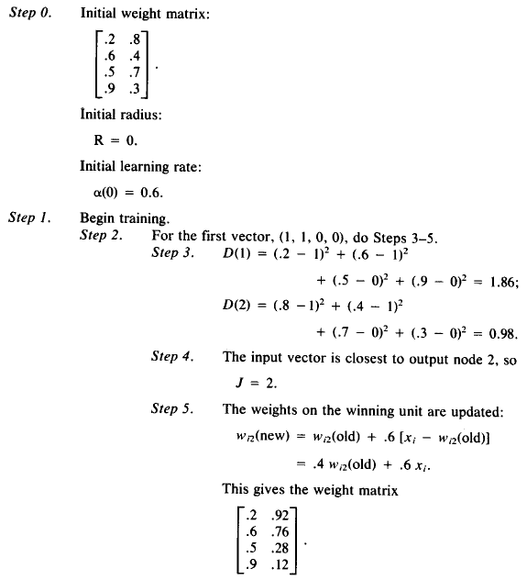

Slide 32
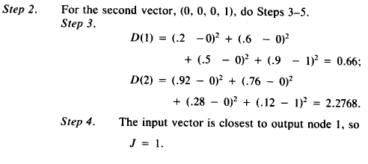
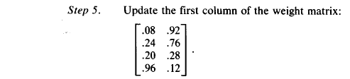

Slide 33
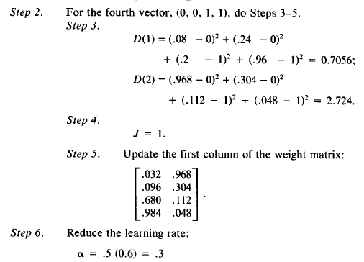

Slide 35
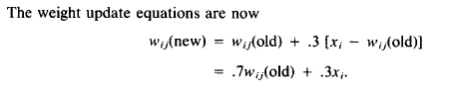
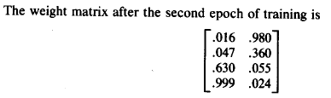
And so on…….

Slide 36
Learning Vector Quantization (LVQ)
Learning Vector Quantization ( or LVQ ) is a type of Artificial Neural Network which also inspired by biological models of neural systems. It is based on prototype supervised learning classification algorithm and trained its network through a competitive learning algorithm similar to Self Organizing Map.

Slide 37
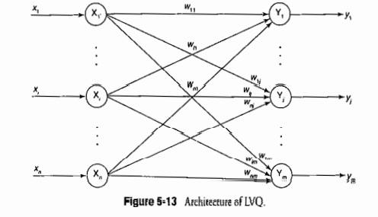
Architecture
Same as KFSOM, with the difference that each output unit has a knowledge about a class it represents

Slide 38
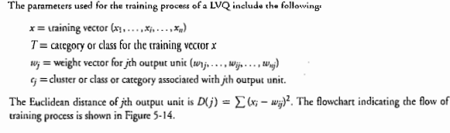
Terminologies (LVQ)

Slide 39
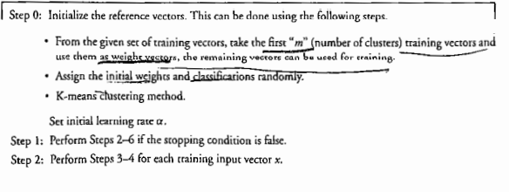
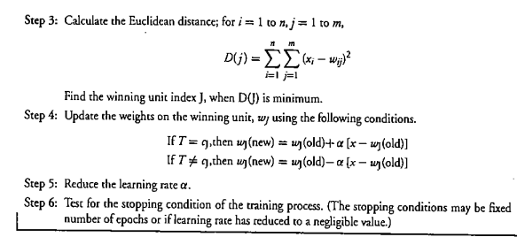
Training Algorithm
C_{J}
Is Class of Jth output unit

Slide 40
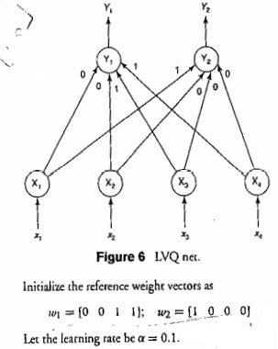
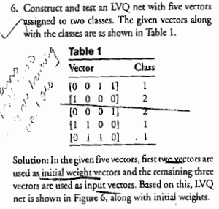
Example

Slide 41
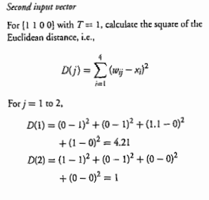
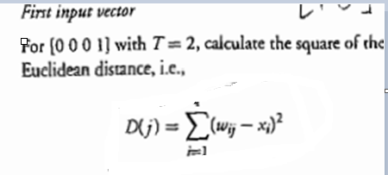
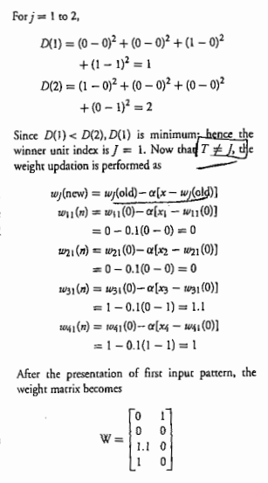
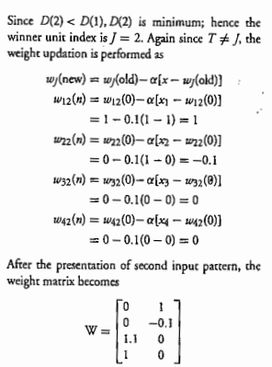

Slide 42
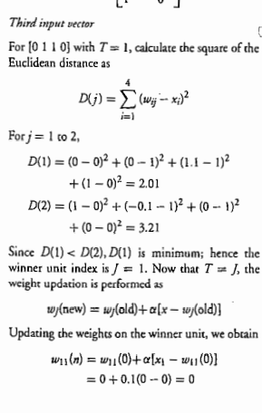
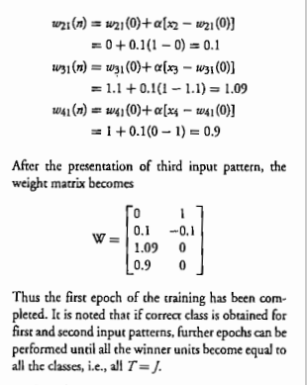

Slide 43
CNN
A Convolutional Neural Network, also known as CNN or ConvNet, is a class of neural networks that specializes in processing data that has a grid-like topology, such as an image. A digital image is a binary representation of visual data. It contains a series of pixels arranged in a grid-like fashion that contains pixel values to denote how bright and what color each pixel should be.

Slide 44
Convolutional Neural Network Architecture
A CNN typically has three layers: a convolutional layer, a pooling layer, and a fully connected layer.

Slide 45
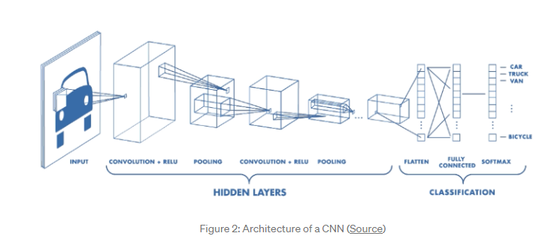
Architecture

Slide 46
convolution layer
The convolution layer is the core building block of the CNN. It carries the main portion of the network’s computational load.
This layer performs a dot product between two matrices, where one matrix is the set of learnable parameters otherwise known as a kernel, and the other matrix is the restricted portion of the receptive field.

Slide 47
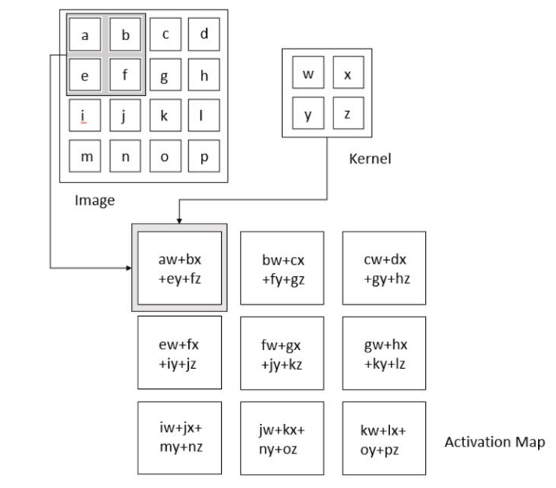
Convolution Operation

Slide 48

If we have an input of size W x W x D and Dout number of kernels with a spatial size of F with stride S and amount of padding P, then the size of output volume can be determined by the following formula:
Padding Input Images
Padding is simply a process of adding layers of zeros to our input images to avoid border issues
Stride is the number of pixels shifts over the input matrix. When the stride is 1 then we move the filters to 1 pixel at a time.

Slide 49
Pooling Layer
The pooling layer replaces the output of the network at certain locations by deriving a summary statistic of the nearby outputs. This helps in reducing the spatial size of the representation, which decreases the required amount of computation and weights. The pooling operation is processed on every slice of the representation individually.
There are several pooling functions such as the average of the rectangular neighborhood, L2 norm of the rectangular neighborhood, and a weighted average based on the distance from the central pixel. However, the most popular process is max pooling, which reports the maximum output from the neighborhood.

Slide 50


Slide 51


Slide 52
Fully Connected Layer
Neurons in this layer have full connectivity with all neurons in the preceding and succeeding layer as seen in regular FCNN. This is why it can be computed as usual by a matrix multiplication followed by a bias effect.
The FC layer helps to map the representation between the input and the output.

Slide 53

Example

Slide 54


Slide 55


Slide 56


Slide 57


